Slide 1



Happiness and Health
Sangeeta Das Bhattacharya MD, MPH
Professor School of Medical Science and Technology
IIT Kharagpur
Science of Happiness and Well-Being Spring 2019

Slide 2

What is Health?
Health is a state of complete physical, mental and social well-being and not merely the absence of disease or infirmity
Preamble to the Constitution of WHO 1948

Slide 3

“Happiness is considered to be the proper measure of social progress and goal of public policy.”
“to redefine the growth narrative to put people’s well-being at the centre of governments’ efforts”
Commissioned by UN Secretary General

Slide 4
World Happiness Report 2016 Update

Slide 5
Update
Markers for measurement:
caring, freedom, generosity, honesty, health, income and good governance
2017
Norway Number 1
Denmark –2
Iceland—3
Switzerland—4
2018
Finland number 1

Slide 6
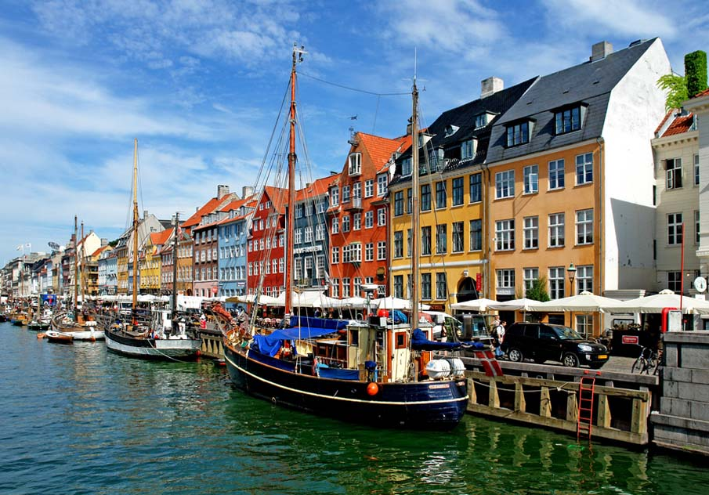

Measures
GDP
Healthy Life expectancy
Generosity
Social Support
Freedom
Corruption Perception
(Trust)
Nyhavn, photo by Joe Routon

Slide 7
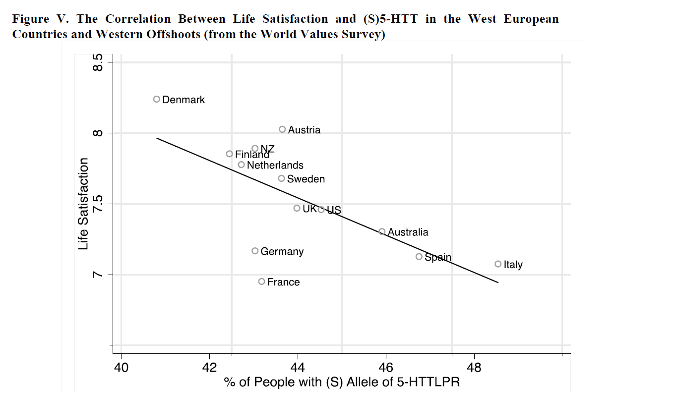
Is there a genetic basis for happiness?
Short form of 5-HTTLPR gene associated with neuroticism, lower life satisfaction and clinical depression.
Danes lowest proportion of people with short form of this gene
National Happiness and Genetic Distance a Cautious Exploration, Proto E Oswald A, IZA Discussion Paper, 2014

Slide 8
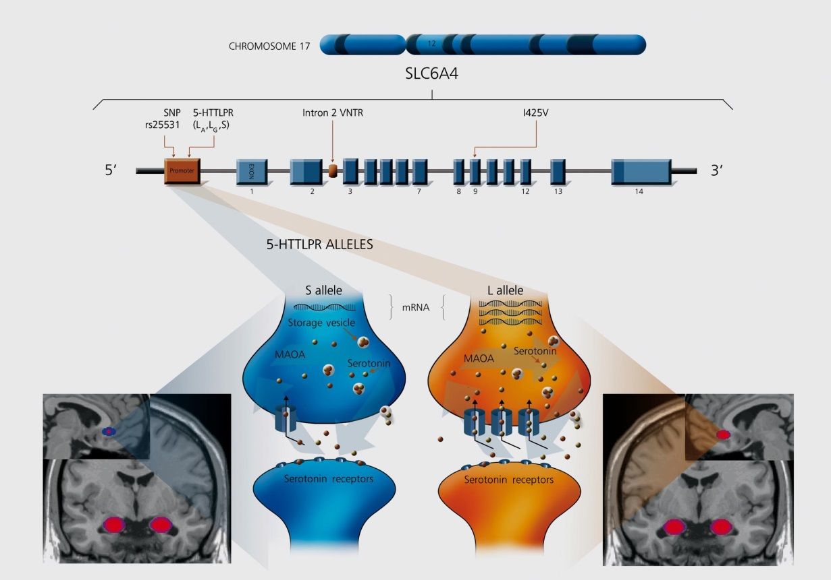
5-HTTLPR
Serotonin Transporter Link Polymorphic Region
Short allele (S) 14 copies
Long allele (L) 16 copies
-Short allele is associated with a reduction in function
- Short allele associated with neuroticism
- Long allele associated with optimism
-variation in responses to antidepressants
-differences in metabolism in parts of the brain including amygdala
Gerretsen et al Dialogues in Clinical Neuroscience 2009

Slide 9
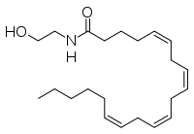
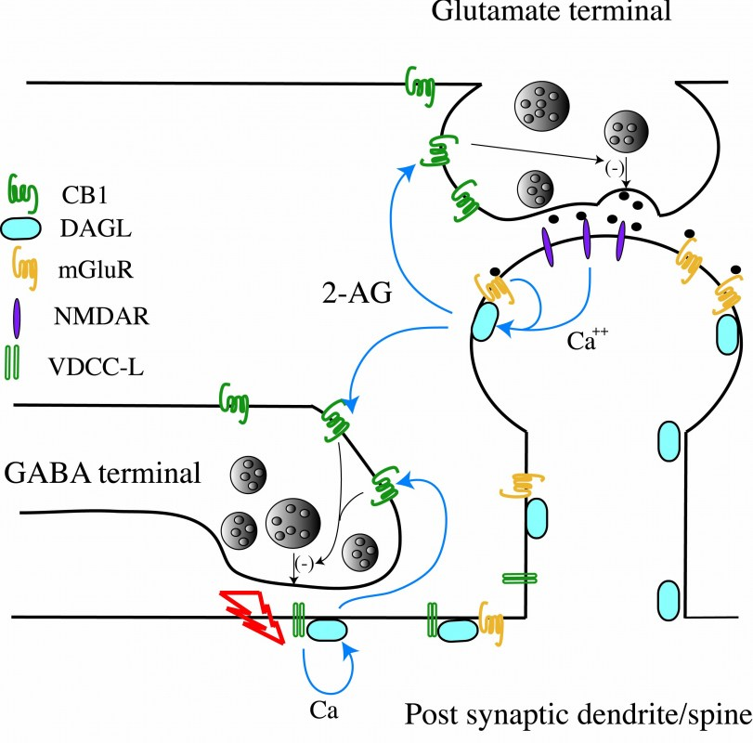
Anandamide (Bliss Molecule)
Neurotransmitter that binds to the cannabinoid receptor and has a calming effect
Endocannabinoid Axis

Slide 10
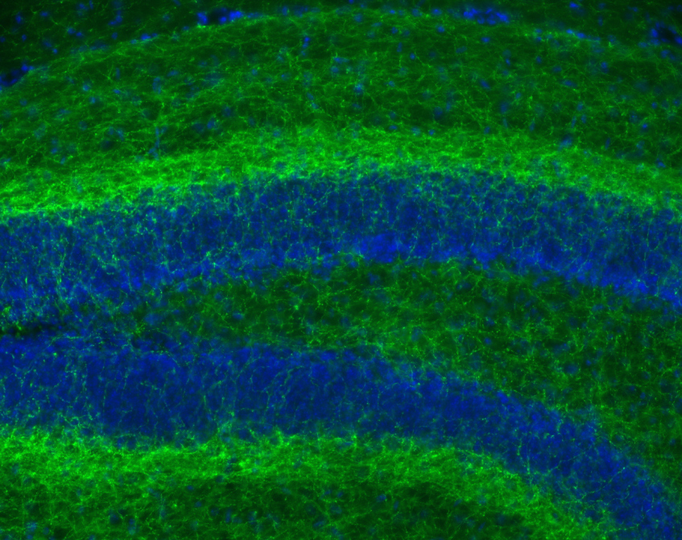
Cannabinoid Receptor
Cannabinoid receptors among the most abundant receptors in the brain
Crick, Frances NIH Director’s blog

Slide 11

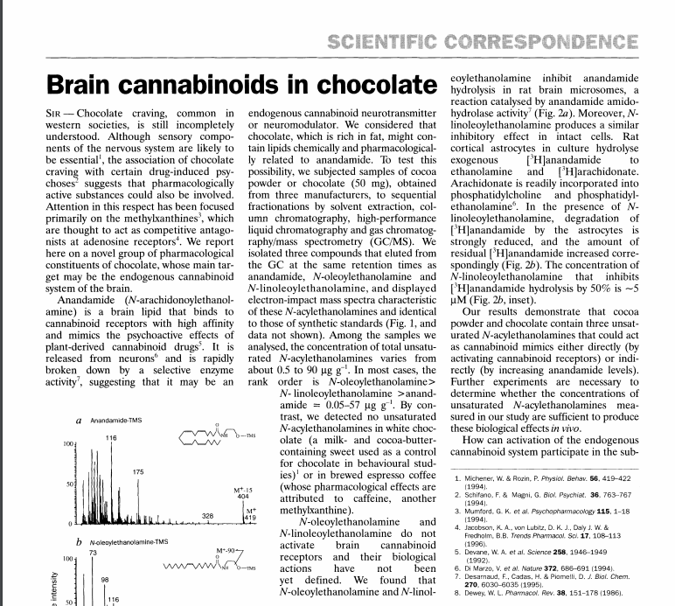

Slide 12

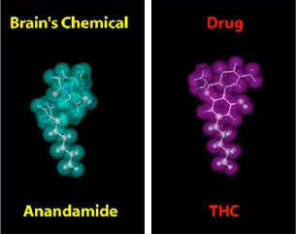
Look alikes
Cannabinoids

Slide 13

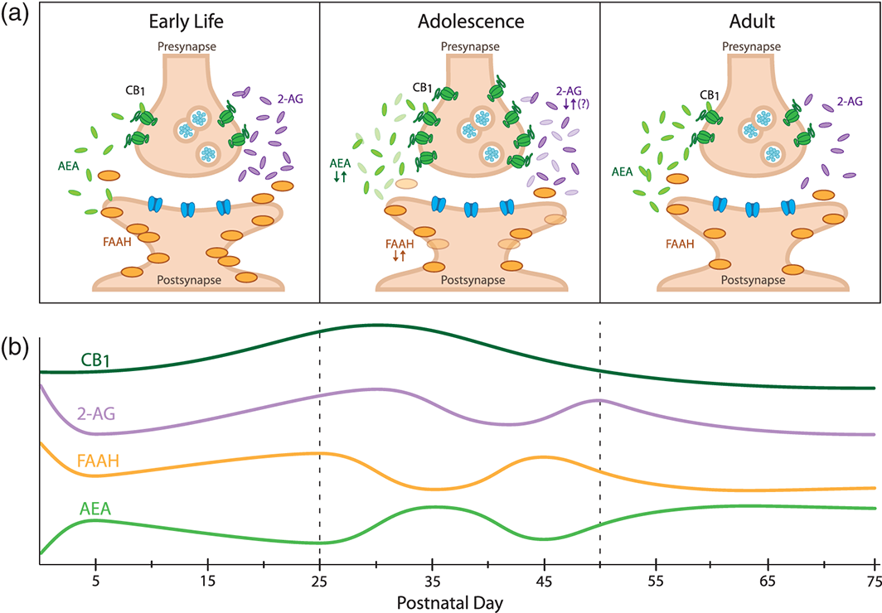
Adolescent and Young Adult THC Exposure Developmental regulation of fear learning and anxiety behavior by endocannabinoids
Reduced stress coping
Increased anhedonia
Increased anxiety
Impaired memory and learning
Lowering of IQ
Genes, Brain and Behavior Volume 15, Issue 1, pages 108-124, 5 NOV 2015 DOI: 10.1111/gbb.12253 http://onlinelibrary.wiley.com/doi/10.1111/gbb.12253/full#gbb12253-fig-0003
Notes:
Corticolimbic endocannabinoid (eCB) signaling changes dynamically across rodent development. (a) Distinct eCB signaling profiles in early life, adolescence and adulthood. Components of the eCB system are represented schematically within a synapse (adapted from(Long et al. ). (b) Developmental trajectories of the components of the eCB system. CB₁ receptor expression peaks with the onset of adolescence. 2‐AG is highest around birth and may fluctuate throughout adolescence. AEA gradually increases during early life and fluctuates during adolescence. FAAH activity fluctuates in reciprocal fashion to AEA during adolescence (based on data from Berrendero et al. ; Ellgren et al. ; Fernandez‐Ruiz et al. ; Heng et al. ; Lee et al. ; Rodriguez de Fonseca et al. ; Rubino et al. ; Wenger et al. ).
IF THIS IMAGE HAS BEEN PROVIDED BY OR IS OWNED BY A THIRD PARTY, AS INDICATED IN THE CAPTION LINE, THEN FURTHER PERMISSION MAY BE NEEDED BEFORE ANY FURTHER USE. PLEASE CONTACT WILEY'S PERMISSIONS DEPARTMENT ON PERMISSIONS@WILEY.COM OR USE THE RIGHTSLINK SERVICE BY CLICKING ON THE 'REQUEST PERMISSIONS' LINK ACCOMPANYING THIS ARTICLE. WILEY OR AUTHOR OWNED IMAGES MAY BE USED FOR NON-COMMERCIAL PURPOSES, SUBJECT TO PROPER CITATION OF THE ARTICLE, AUTHOR, AND PUBLISHER.

Slide 14

Genetic Mutation in FAAH gene -Enzyme that deactivates Anandamide
Less of the enzyme FAAH which deactivates anandamide
More anandamide around
Less anxious
More forgetful of bad experiences
Higher levels of anandamide
20% of population have this mutation
Less likely to have addiction to marijuana

Slide 15
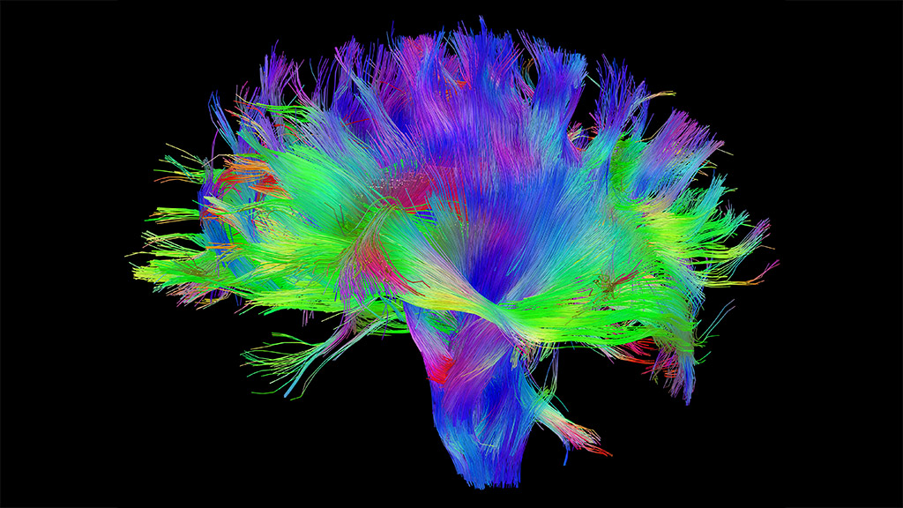
Human Connectome Project

Slide 16
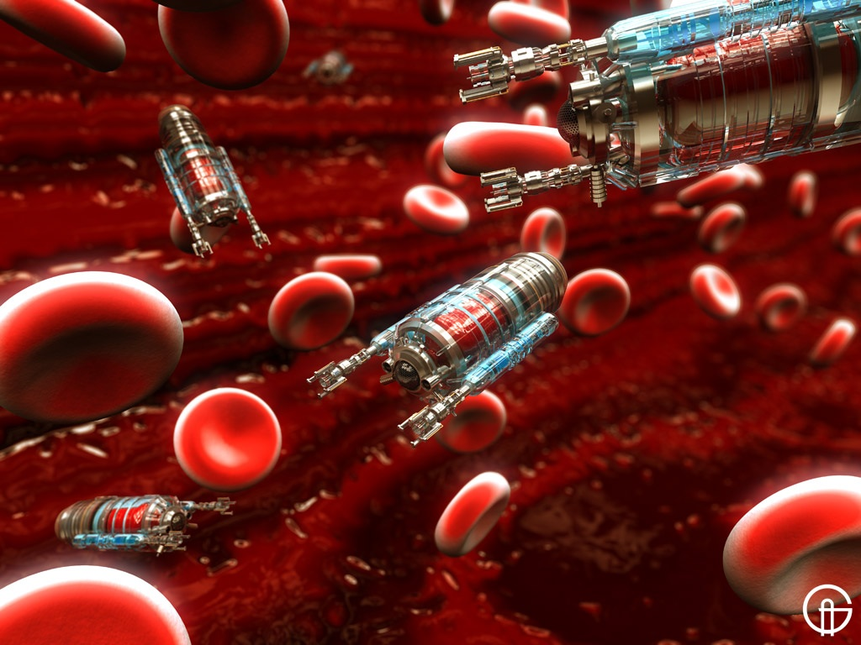
Neurochemicals
Should we combine robotics and nanotechnology to make mood bots that could be ingested and then travel into the brain and turn on or off specific genes related to a happiness set point?

Slide 17

What are we talking about?
Hedonic Happiness
-a positive mental high
Eudaimonic Happiness
“Happiness is the meaning and purpose of life, the whole aim and end of human existence”
Aristotle
Nicomachean Ethics, Aristotle 350 BC

Slide 18
How do you imagine a life well-lived?

Slide 19
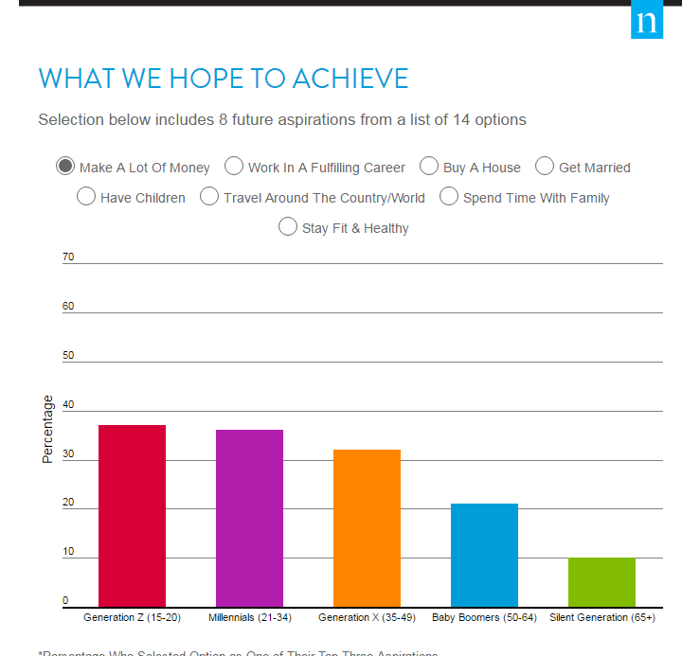
To what do you aspire?

Slide 20

Grant Gluek Study: Harvard Study of Adult Development
Prospective Cohort Study that is now 75 years old
-started in the late 1930’s with two groups
-268, 19 year old white male Harvard students
- 456, 11-16 year old boys growing up in difficult Boston neighborhoods
Followed these people throughout their lives
Every 2 years
-interviews
-medical histories
-blood tests
-family interviews

Slide 21
What keeps us healthy and happy throughout our lives?

Slide 22
-Dr. Robert Waldinger, DIRECTOR Harvard Adult Development Study
Good relationships keep us happier and healthier.

Slide 23

Social Connections
-Key to well being
-Loneliness bad
-People with good quality social connections and relationships, live longer, happier, and healthier
Reach Out Week 2014
Lights Out, Jnan Ghosh Stadium

